Slide 1
8257 : Direct Memory Access (DMA) Controller

Slide 2
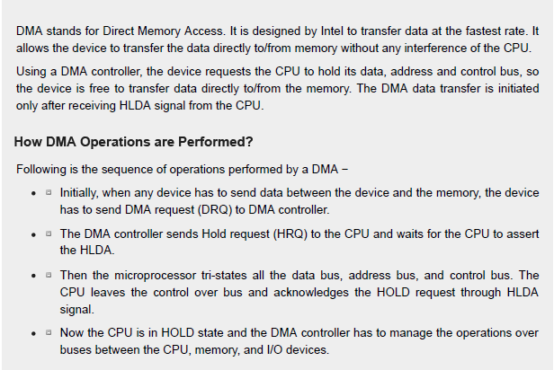

Slide 3
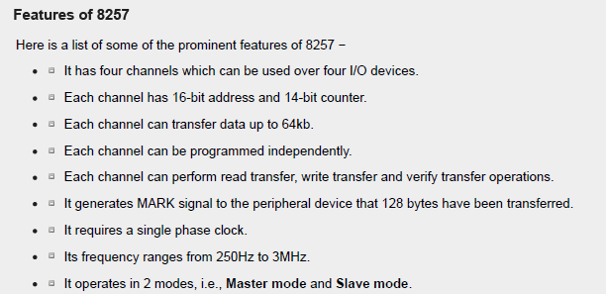

Slide 4
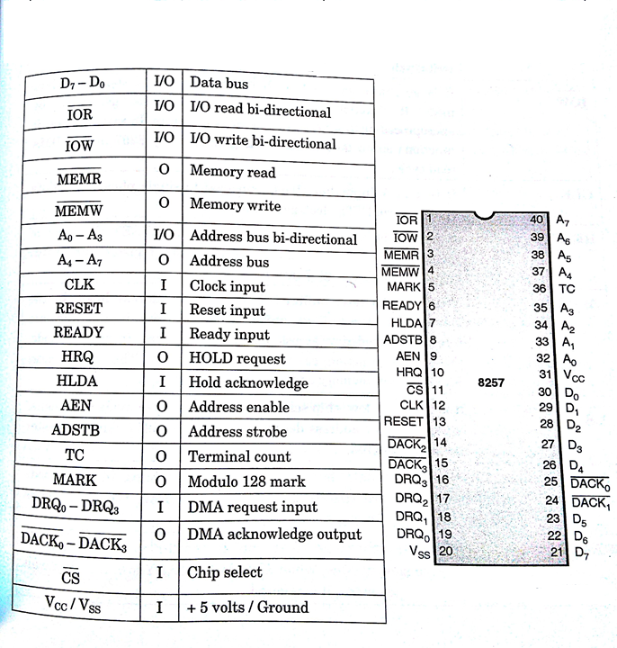

Slide 5
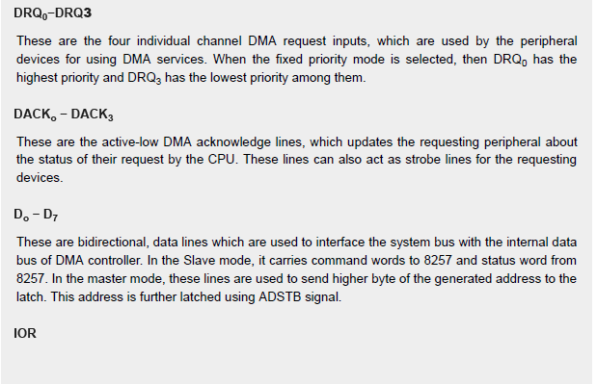

Slide 6
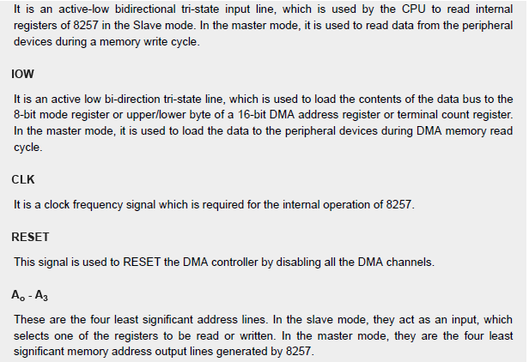

Slide 7
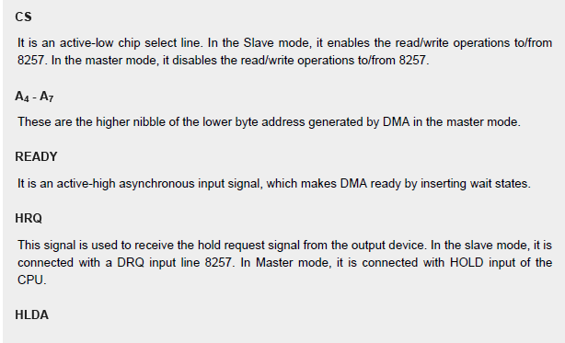

Slide 8
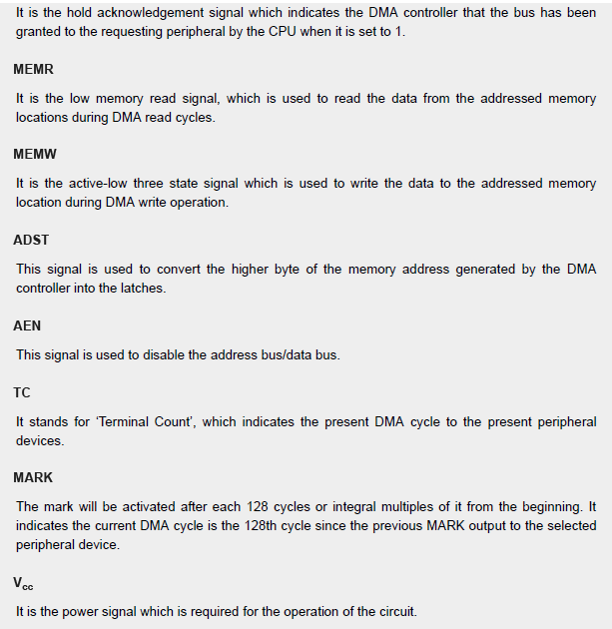

Slide 9
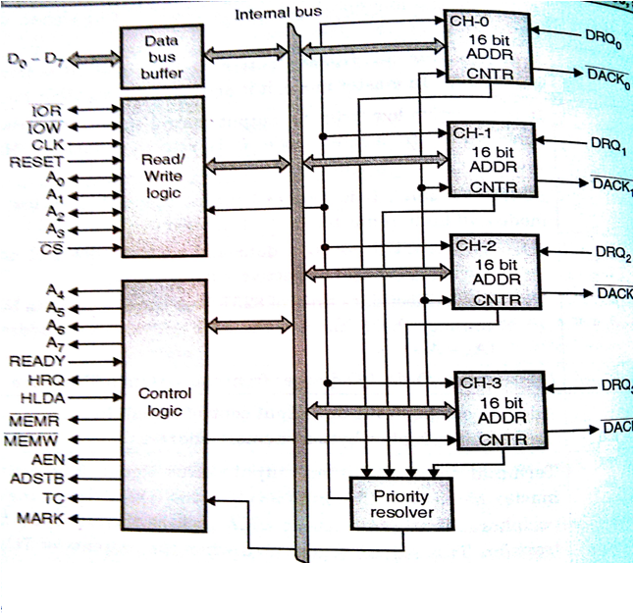
Block Diagram

Slide 10
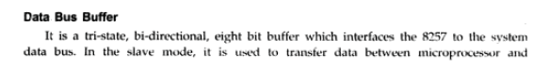
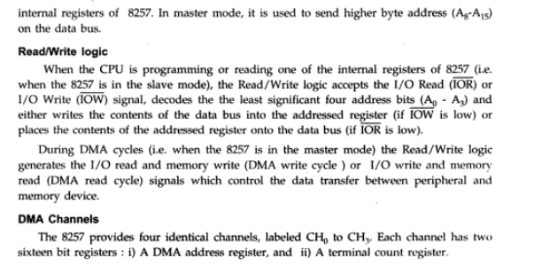

Slide 11
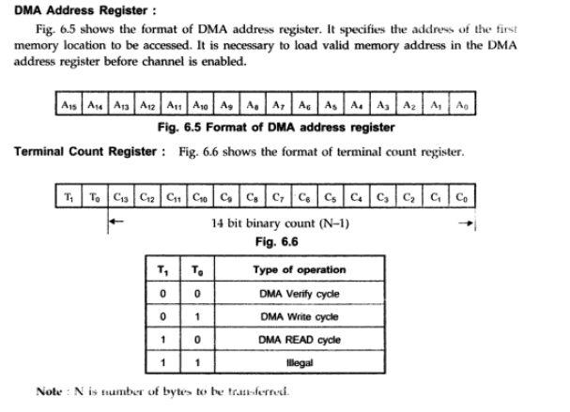

Slide 12
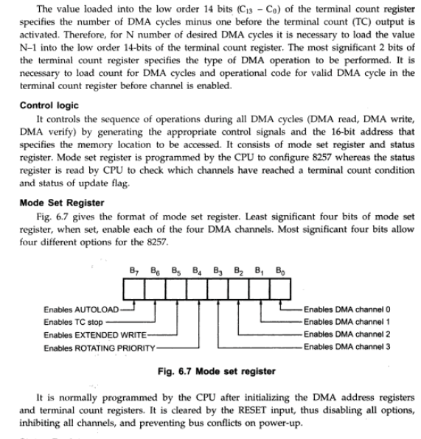

Slide 13
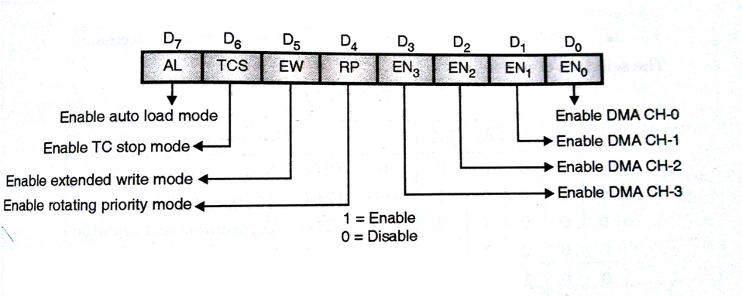
Mode Set Register

Slide 14
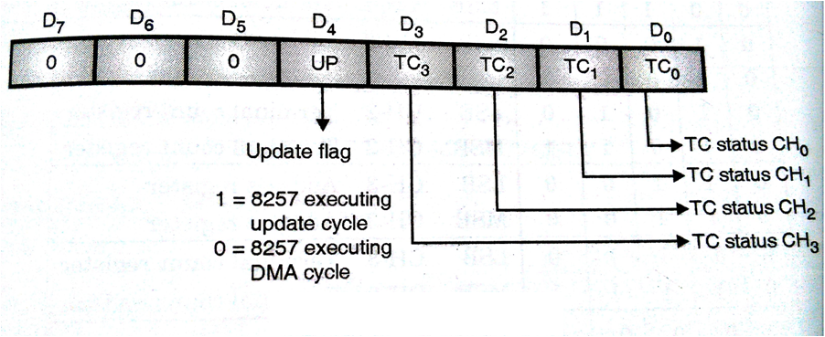
Status Register

Slide 15
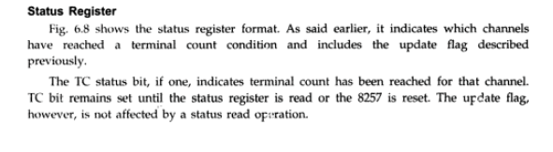
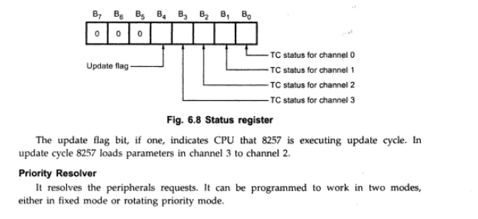

Slide 16
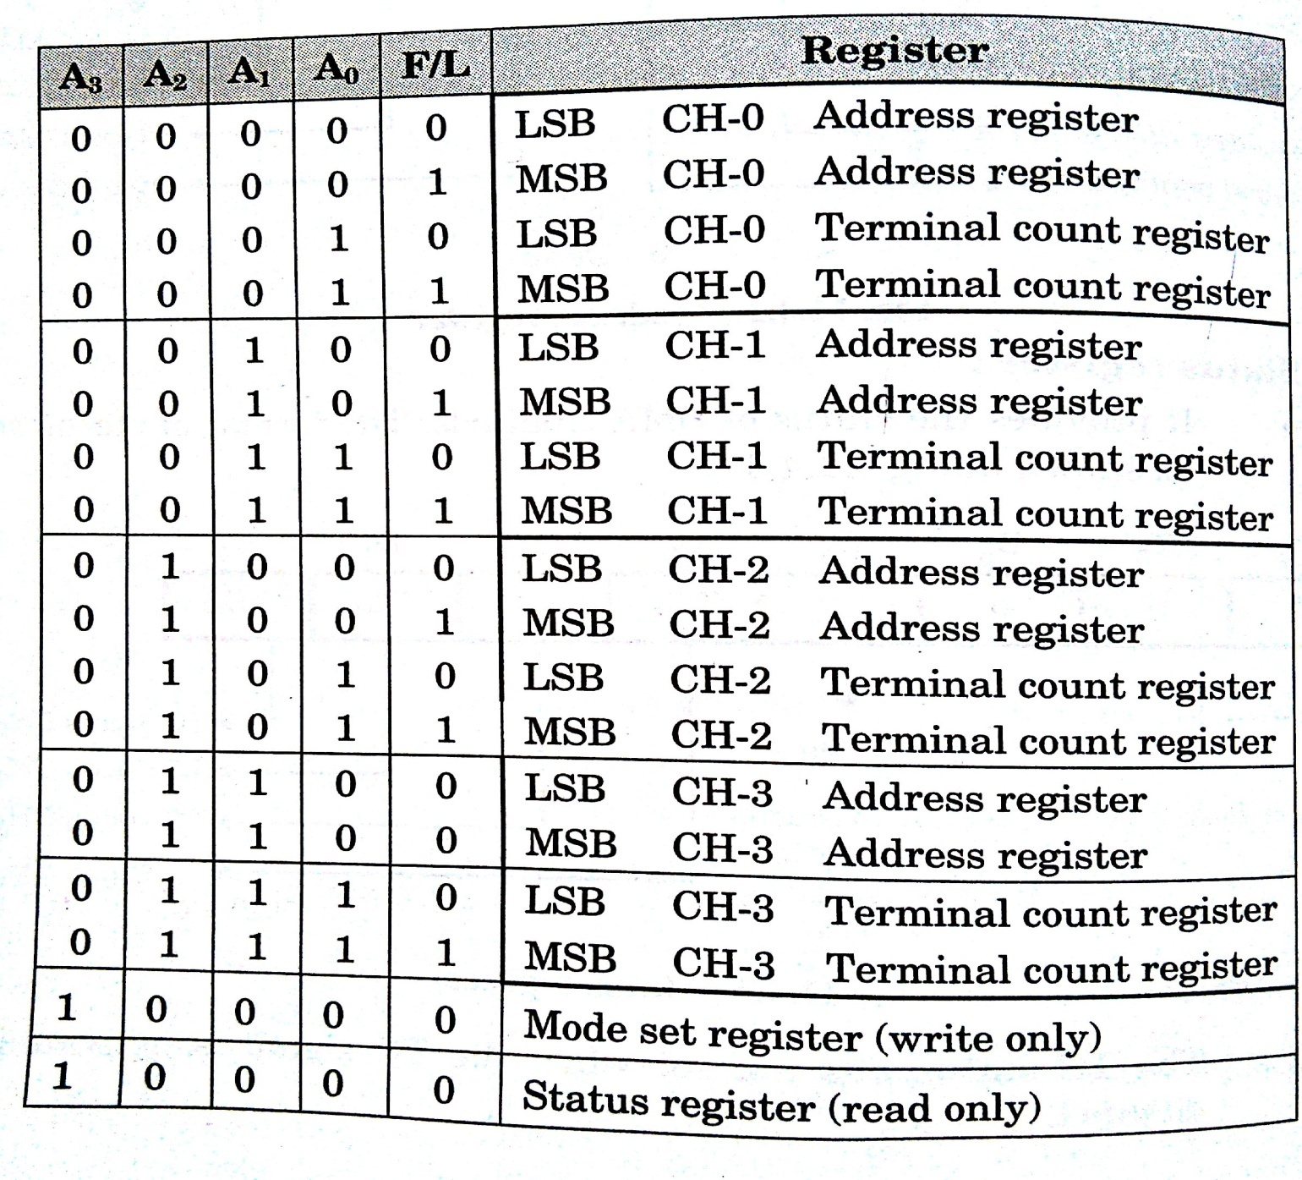

Slide 17
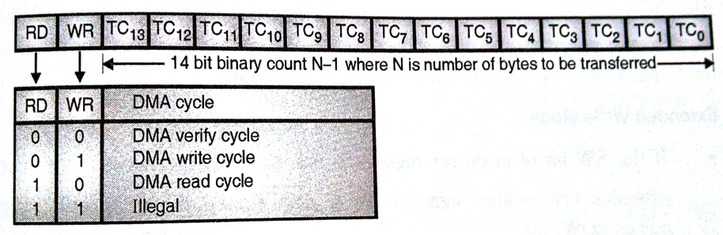
Terminal Count Register

Slide 18
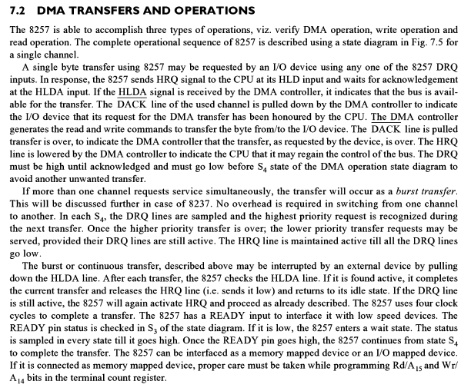

Slide 19
Operating Modes of 8257
Rotating Priority Mode
Fixed Priority Mode
Extended Write Mode
TC Stop Mode
Autoload Mode

Slide 20
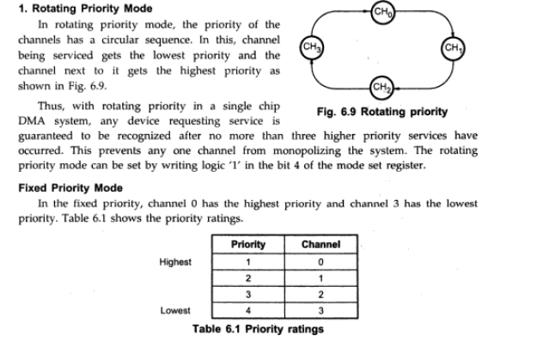

Slide 21
3. Extended Write Mode :
Microcomputer systems allow use of various types of memory and I/O devices with different access time. If a device can not be accessed within a specific amount of time it returns a “not ready” indication to the 8257 that causes the 8257 to insert one or more wait states in its internal sequencing. The extended write option provides alternative timing for the I/O and memory write signals which allows the devices to return an early READY and prevents the unnecessary occurrence of wait states in the Operating Modes of 8257. It does this by activating MEMW and IOW signals earlier in the DMA cycle, giving more setup time.
4.TC STOP Mode :
If the TC stop bit is set, a channel is disabled (i.e. its enable bit is reset) after the terminal count (TC) output goes high, thus automatically preventing further DMA operation on that channel. To enable DMA operation on the channel it is necessary to set enable bit of the corresponding channel in the mode set register. If the TC STOP bit is not set, the occurrence of the TC output has no effect on the channel enable bits.

Slide 22
5. Auto Load Mode :
Auto load Mode when enabled, permits block chaining operations, without immediate software intervention between blocks. In this mode, channel 2 parameters (DMA starting address, terminal count and DMA transfer mode) are initialized as usual for the first data block. These parameters are automatically duplicated in the channel 3 registers when channel 2 is initialized. After the first block of DMA cycles is executed by channel 2 (i.e., after the TC output goes high), the parameters stored in the channel 3 registers are transferred to channel 2 during an ‘update’ cycle and next block of DMA cycle is executed. This repeat block operations can be used in applications such as CRT refreshing.
During the update cycle, it is necessary to prevent the CPU from inadvertently skipping a data block by overwriting a starting address or terminal count in the channel 3 registers before those parameters are properly auto-loaded into channel 2.

Slide 23
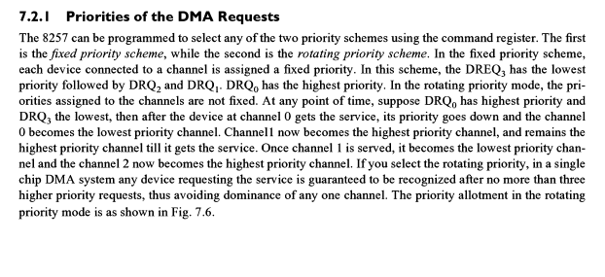

Slide 24
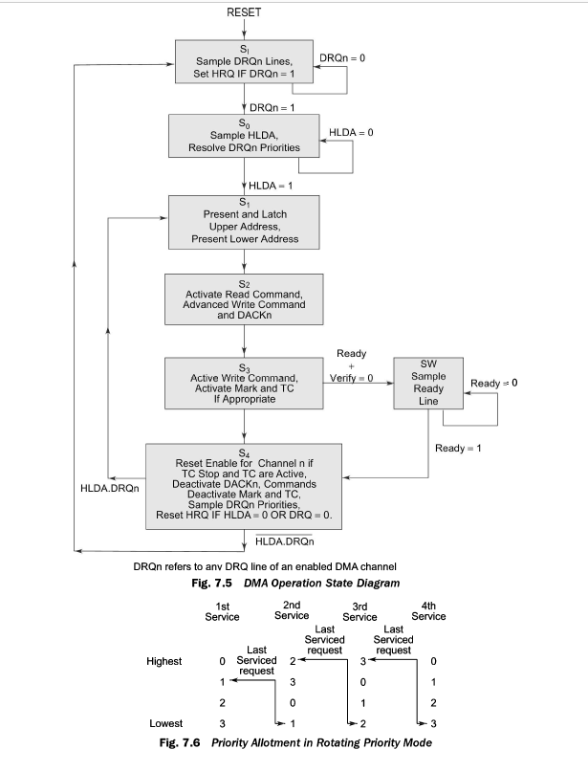

Slide 25
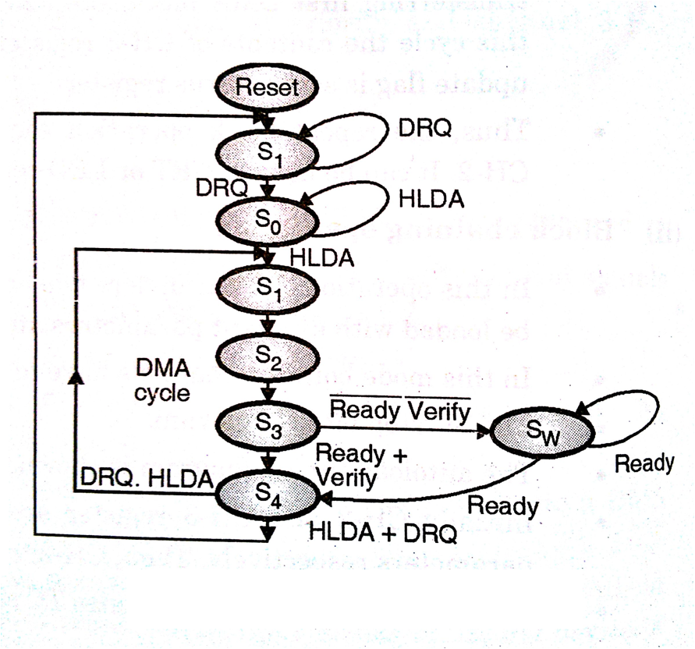
State Diagram of 8257

Slide 26
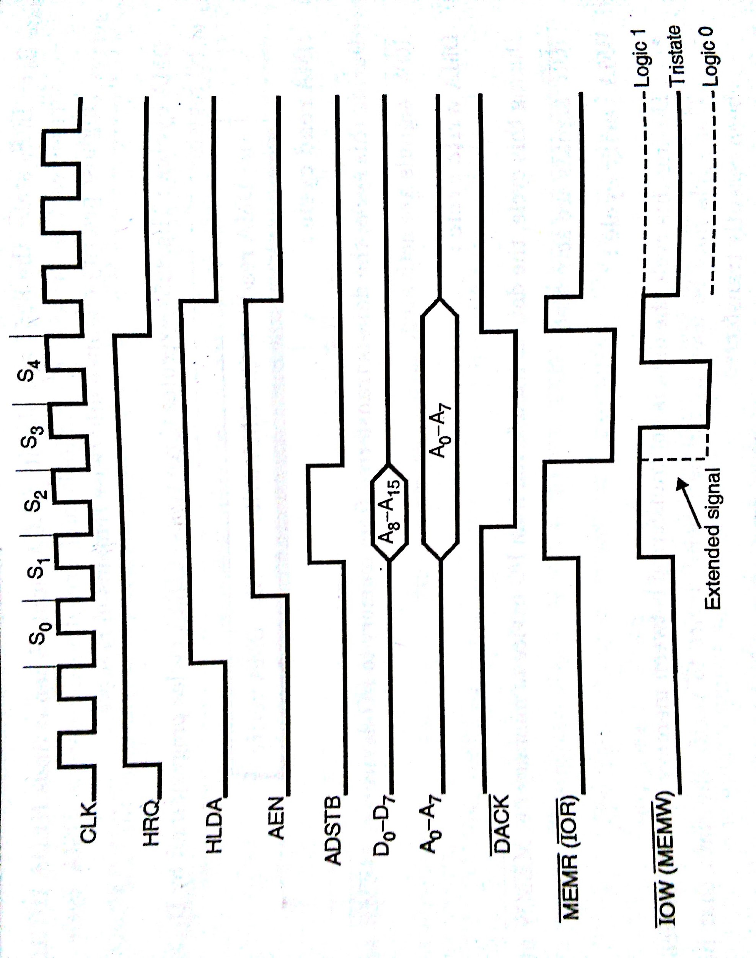
Operation Of DMA Controller

Slide 27
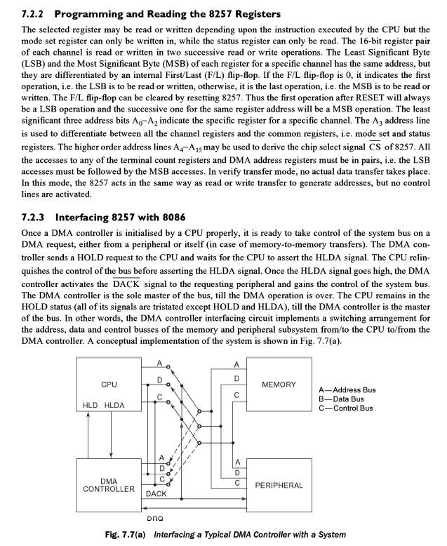

Slide 28
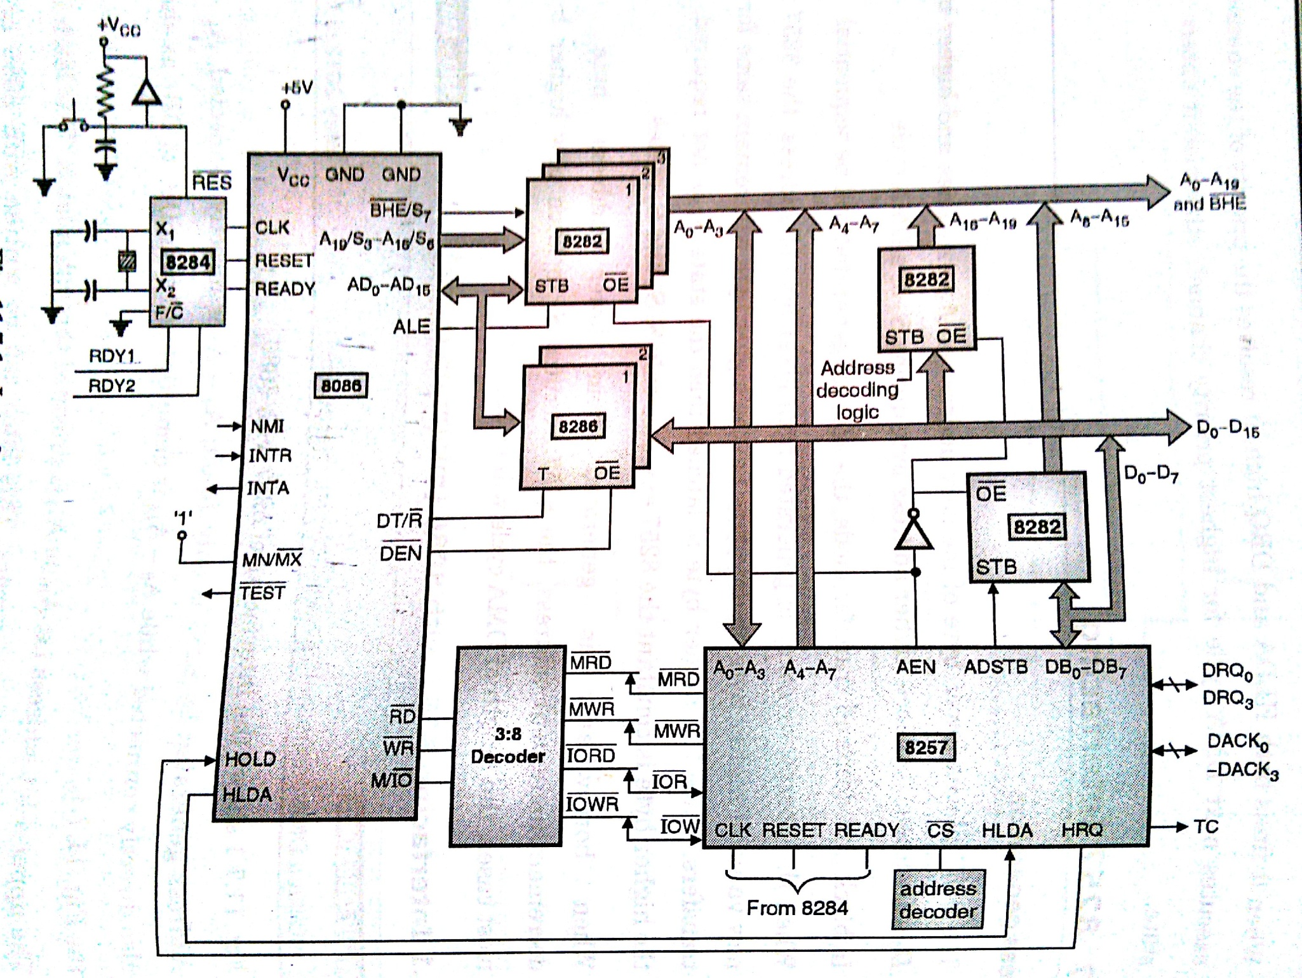

Slide 29
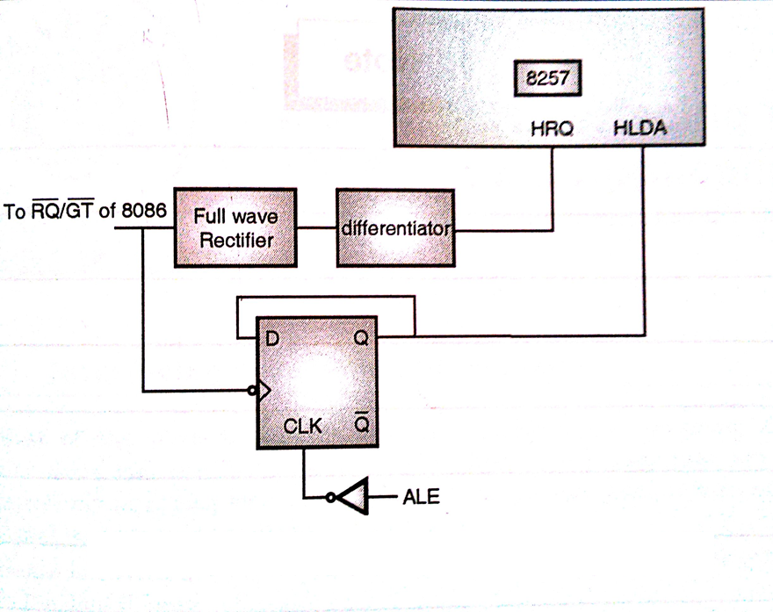
Interfacing in Maximum Mode

